Slide 1
GNU/Linux System Support
CST8207
Week-1
Sep 10th, 2025
By: Gurpreet Singh Sidhu

Slide 2
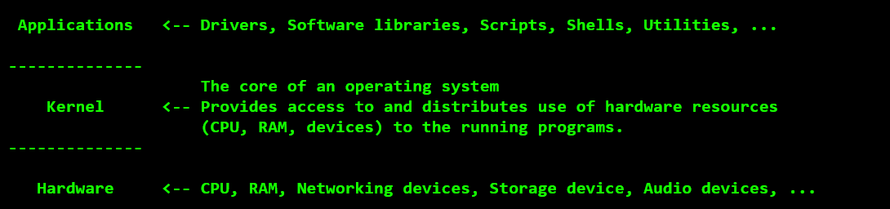
WHAT IS OPERATING SYSTEM and WHY WE NEED OPERATING SYSTEM ?
An operating system is a set of programs that act as a interface between the computer and the user
Controls the execution of all kinds of programs.
The job of an Operating System is to manage the computer hardware so that multiple programs can use it. Examples of hardware that needs managing include memory, CPU, and peripherals. You don’t want one program to cause another program to crash, and you want to share memory among several programs at the same time.

Slide 3
WHAT IS VIRTUALIZATION FOR ?
Virtualization allows using existing hardware for both the actual computer and the virtual one, if the hardware sufficiently matches, and most computation takes place on the actual CPU of the host.
ADVANTAGES OF USING A VIRTUAL MACHINE FOR LEARNING
Running and switching between operating systems seamlessly, without a restart
Safe environment for making mistakes: quickly backup and restore your VM state using Snapshots
Easy to create and remove operating system installations

Slide 4

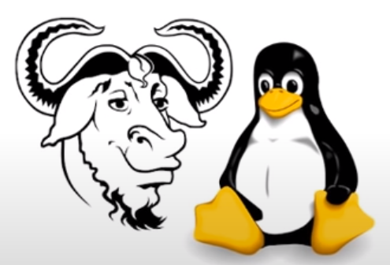

THE HISTORY OF UNIX AND GNU-LINUX
1975
Growth of UNIX because of open-source and collaboration
Commercial sale of UNIX
1969-1970
Birth of ‘C’ and UNIX OS
1980
> Companies developing their own Unix:- IBM(AIX), Solaris (Sun OS), HP (HP-UX)
1990s
Linus Torvalds put the linux Kernal source code online.
Resulted in usage of ‘Linux + GNU’
Mid-to-late 1980s
Richard Stallman announced the GNU project
Birth of free software movement
GNU Project

Slide 5
THE HISTORY OF UNIX AND GNU-LINUX
UNIX system was developed by researchers in Bell Labs at the 1970s.
who needed a set of modern computing tools to help them with their project
It allowed several users to share selected parts of a project, while keeping others private.
In 1975 the UNIX OS became widely available and Bell labs offered it to educational institutes.
In 1983 Richard Stallman announced the GNU project for creating an OS (kernel and system program)
The name “GNU” is a recursive acronym for “GNU's Not Unix.
In 1991 GNU project has moved well along toward its goal. Much of the GNU OS, Except kernel, is complete.

Slide 6
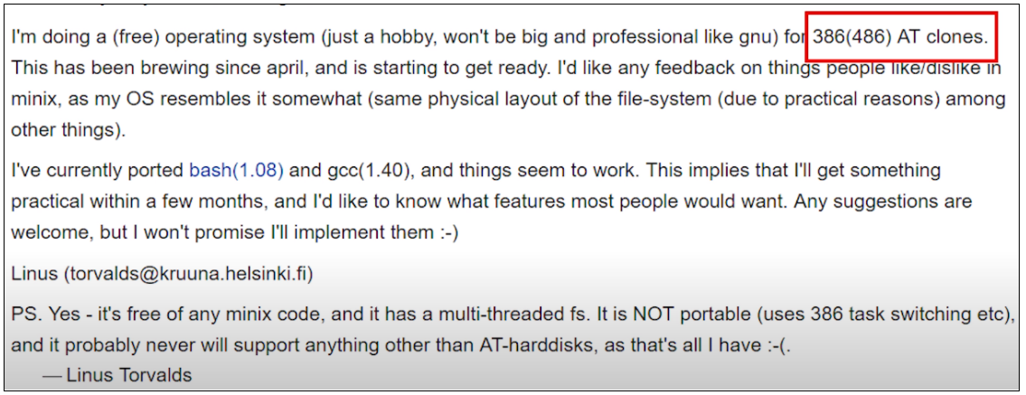
THE HISTORY OF UNIX AND GNU-LINUX
People took the working Linux kernel originated by Linus Torvalds and added all the Unix-compatible GNU utility software from the FSF.
In 1991 Linus Torvalds made the below announcement

Slide 7
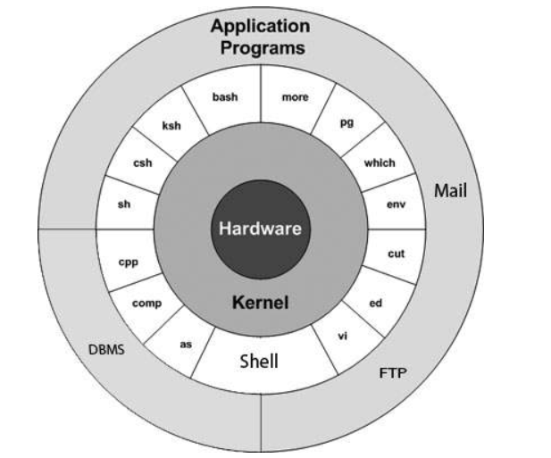
What is Unix
Unix is an operating system developed by researchers in Bell Labs in1970s.
Modern computing tool
It allowed several users to share selected parts of a project, while keeping others private.
Example:-
- Hewlett Packard (HP-UX)
- IBM AIX
- Oracle Solaris
- BSD

Slide 8
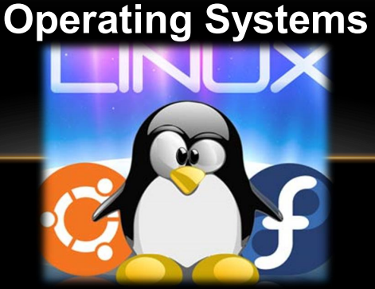
UNIX AND UNIX “like”

Slide 9
Linux is a Kernel or an Operating System?
The kernel of the operating system is named Linux, but it’s very common to call the whole operating system Linux.
You should know, that Linux is the kernel and together with the GNU applications they form a complete operating system, called GNU/Linux, as the name of our course.
Therefore, any operating system that utilizes the Linux kernel is generally referred to as a Linux “based” operating system

Slide 10
Linux OS Examples:
In the Linux market there are many Linux distributions which some of them are gone and some still in the markets.
The more popular Linux operating system platforms include:
- Red Hat Enterprise Linux
- CentOS Linux
- Oracle Linux
- Ubuntu Linux
- Debian Linux
Fedora
These are currently active

Slide 11
WHY LINUX?
Linux is an open-source operating system that provides access to source code, Developer can alter the code and customizes the OS according to its needs.
Cost-effective - The costs are almost free for all programs, utilities, and complex applications. which in a lot of other OS you have to pay for these utilities and it is not a small price
Highly secure - it is easy to identify bugs and fix from any part of the world as it is community developed, whereas something such as windows which has a large user base becomes a target for developers of viruses and malware.

Slide 12
WHY LINUX?
Runs faster- Less clustering
For Example : Users are becoming less reliant on the desktop and more reliant on the web. Do you need all your processing power taken up with the operating system, or do you want something with a lighter footprint, letting you get on with your work and play?
The Linux operating system and its derivatives are found in very high-profile places such as Android phones, Google, Facebook, and the New York Stock Exchange. If you want to work with leading-edge technology, you need to know how to work with Linux.
How Linux is Built (2012)
The Story of Linux (2011)

